Slide 1


Travel Resource For the Berkshire Area
Alyssa Nicole | Chibu Agbanyim | Dimitris Dimitriadis | Χρίστος Τσαγκαρίδης

Slide 2
James
( Need to add picture)
James Stephens
23 years old
Worker
Lives in London

Slide 3
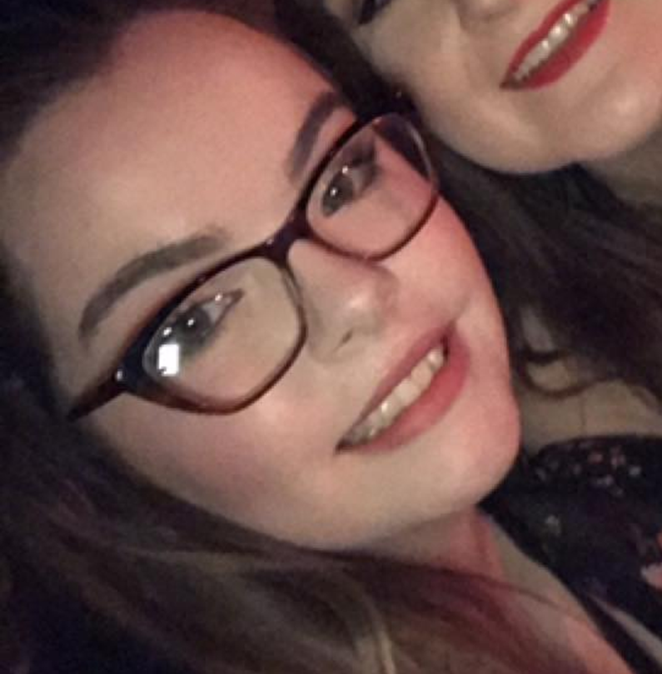
Roberta Back
Roberta Black
19 years old
Student
Studies at Reading University

Slide 4
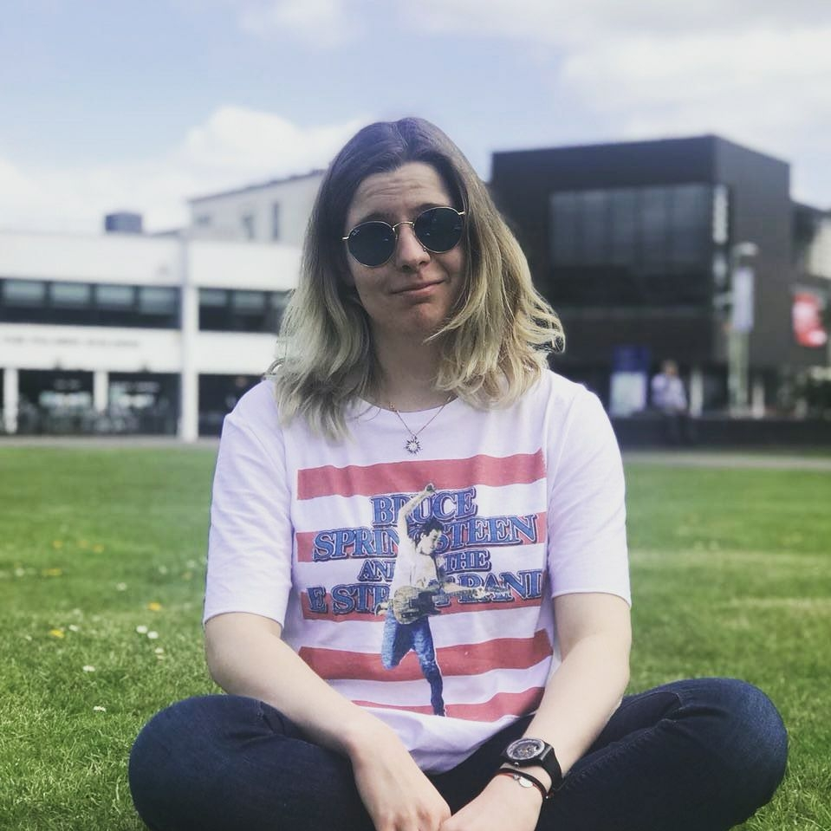
Nataliya
Nataliya Lazutkina
20 years old
Student
Studies At Reading University

Slide 5
Questions
Have you ever used online travel resources? If so, what for?
Has using online travel resources assisted in the planning of a trip?
How often are online travel resources used to make travel plans?
How often are online travel resources used to make travel plans?

Slide 6
Questions pt.2
Are there any aspects that prevent/affect your travel plans?
What is your main form of transport for these trips?
What type of business do you intend on doing when in the Berkshire area?
What would you like to see in an online travel resource?

Slide 7
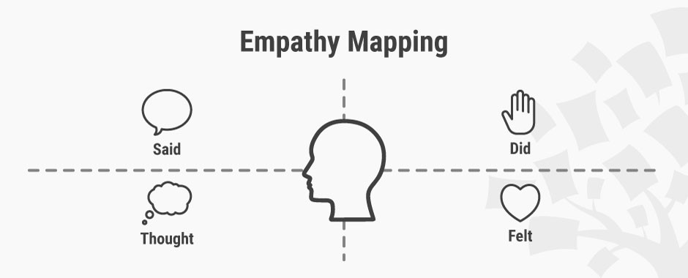
Empathy Map
Say
Think
Do
Feel

Slide 8
James Stephens – 23 year old worker.
Think
SAY
“I also like to check travel prices without the intention of going on holidays just recreationally.”
Believes travel websites are heavily reliant on user reviews.
Values ease of use.
“I use travel a travel resource every time when visiting a new place”
Makes travelling much more convenient.
“Helped to plan budget and time upfront”
Suspicious that some travel websites are a scam
Frowned at the fact some travel website provide wrong information and often over sell activities
Hardest factor for travelling is timing.
Feel
Do

Slide 9
Roberta Black – 19 Student
Think
SAY
Believes using a travel resource is essential for planning a trip
“It has made it easier as I can plan my trips whenever I want at any time.”
The ability to use a travel resource on multiple devices is key
Ability to compare different costs
“Anytime I am planning a trip, I have to use online travel resources.”
24/7
“I would definitely use it to have some new experiences”
Became excited when talking about cross-platform use.
As a university student, it is essential to get the cheapest methods
When talking about budget looked very serious
Feel
Do

Slide 10
Nataliya Lazutkina – 20 Student
Think
SAY
Travel Resources mainly used for leisure or studying
“I used City Mapper on multiple occasions to find my way around city transports.”
Budget is the main focus of a travel resource
Uses travel resource "Every time when visiting a new place.”
“If you give a service your preferences and budget and it plans all the travels and stays included according to
the budget mentioned”
Made a intrigued faced when asked if ever used a travel resource to educate herself
Sad that travel resources removes the spontaneous moments on a trip spirit
Made a sad face, at the thought of “losing the adventure spirit”
Easier to plan trips
Feel
Do

Slide 11

Point of Views (PoV) and HMWs
Point of view of each interviewee and crucial information picked up is highlighted or in yellow
3 HMW’s for each candidate
The How might we highlighted is the one selected for a solution

Slide 12
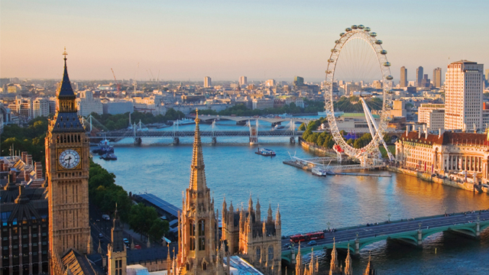
James Stephens PoV
We met James who is a worker that works in London for flex trade.
James was the first to be interviewed , we were very interested to find out just how much he relied and used tourist resources, but not to explicitly plan trips as he mentioned “I also like to check travel prices without the intention of going on holidays just recreationally.”
It would be ground breaking if we could also use our travel website as a form of education users on the local Berkshire area

Slide 13
James Stephens – (First HMW) (Recreational use)
HMW Educate people on the local Berkshire area and showing the available activities?
HMW Ensure no scams or exaggerations about attractions are allowed?
HMW Make the travel resource easy to use?

Slide 14
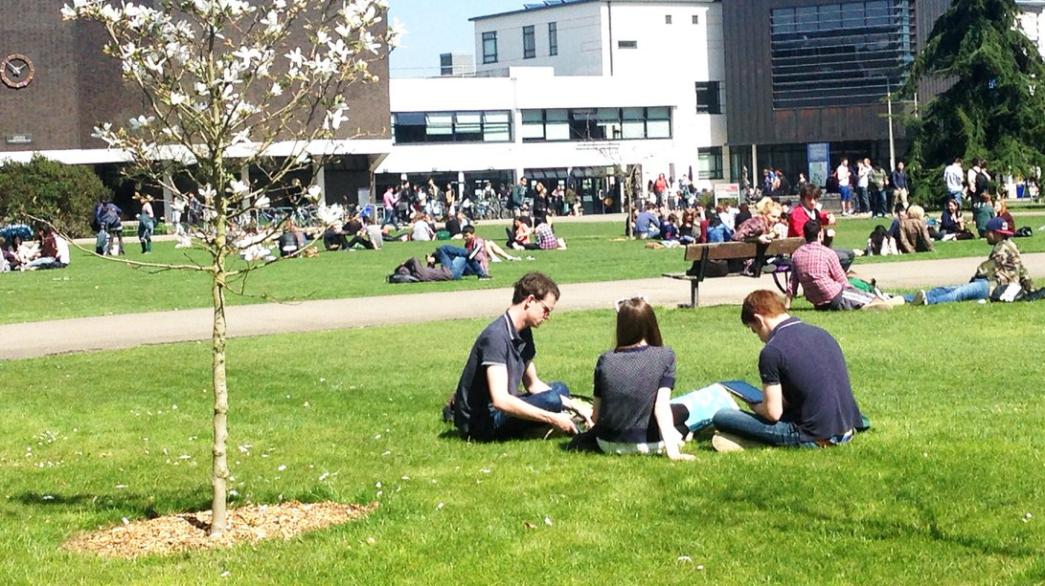
Roberta Black PoV –
We interviewed Roberta, a 2nd year reading university student.
Roberta made us realise that an easy to use resource as well as being able to use a travel resource on multiple devices and on the go is very beneficial and a need in this new age.
It would be amazing to produce a travel resource which works on multiple devices and can be used and progress saved to be accessed later.

Slide 15
Roberta Black – (Second HMW) (Ease of Use)
HMW enable a new experience each time?
HMW enable students on a budget to travel with ease?
HMW make travelling more convenient?

Slide 16
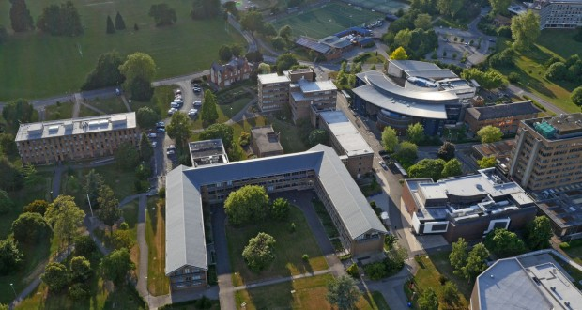
Nataliya Lazutkina - PoV ()
We met Nataliya, a student from reading university.
We were surprised to discover that although Nataliya would use a travel resource she was sad to “losing the adventure spirit”
It would be game changing to be able to recommend places to visit or stay without spoiling the main selling point or attraction if the person desires.

Slide 17
Nataliya Lazutkina – (Third HMWs)
HMW User reviews a main focus of the website.
HMW implement the surprise element and adventurous
HMW Value for money an ability to check on a travel resource website

Slide 18
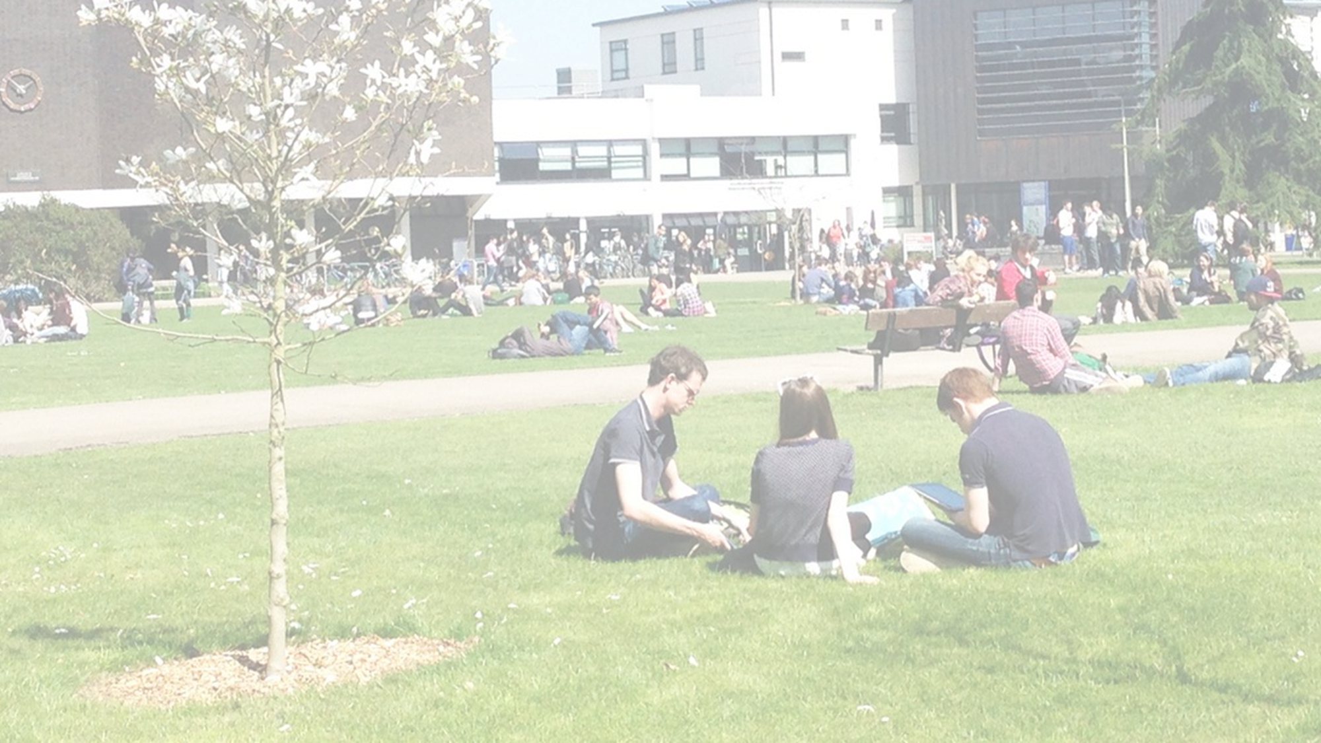
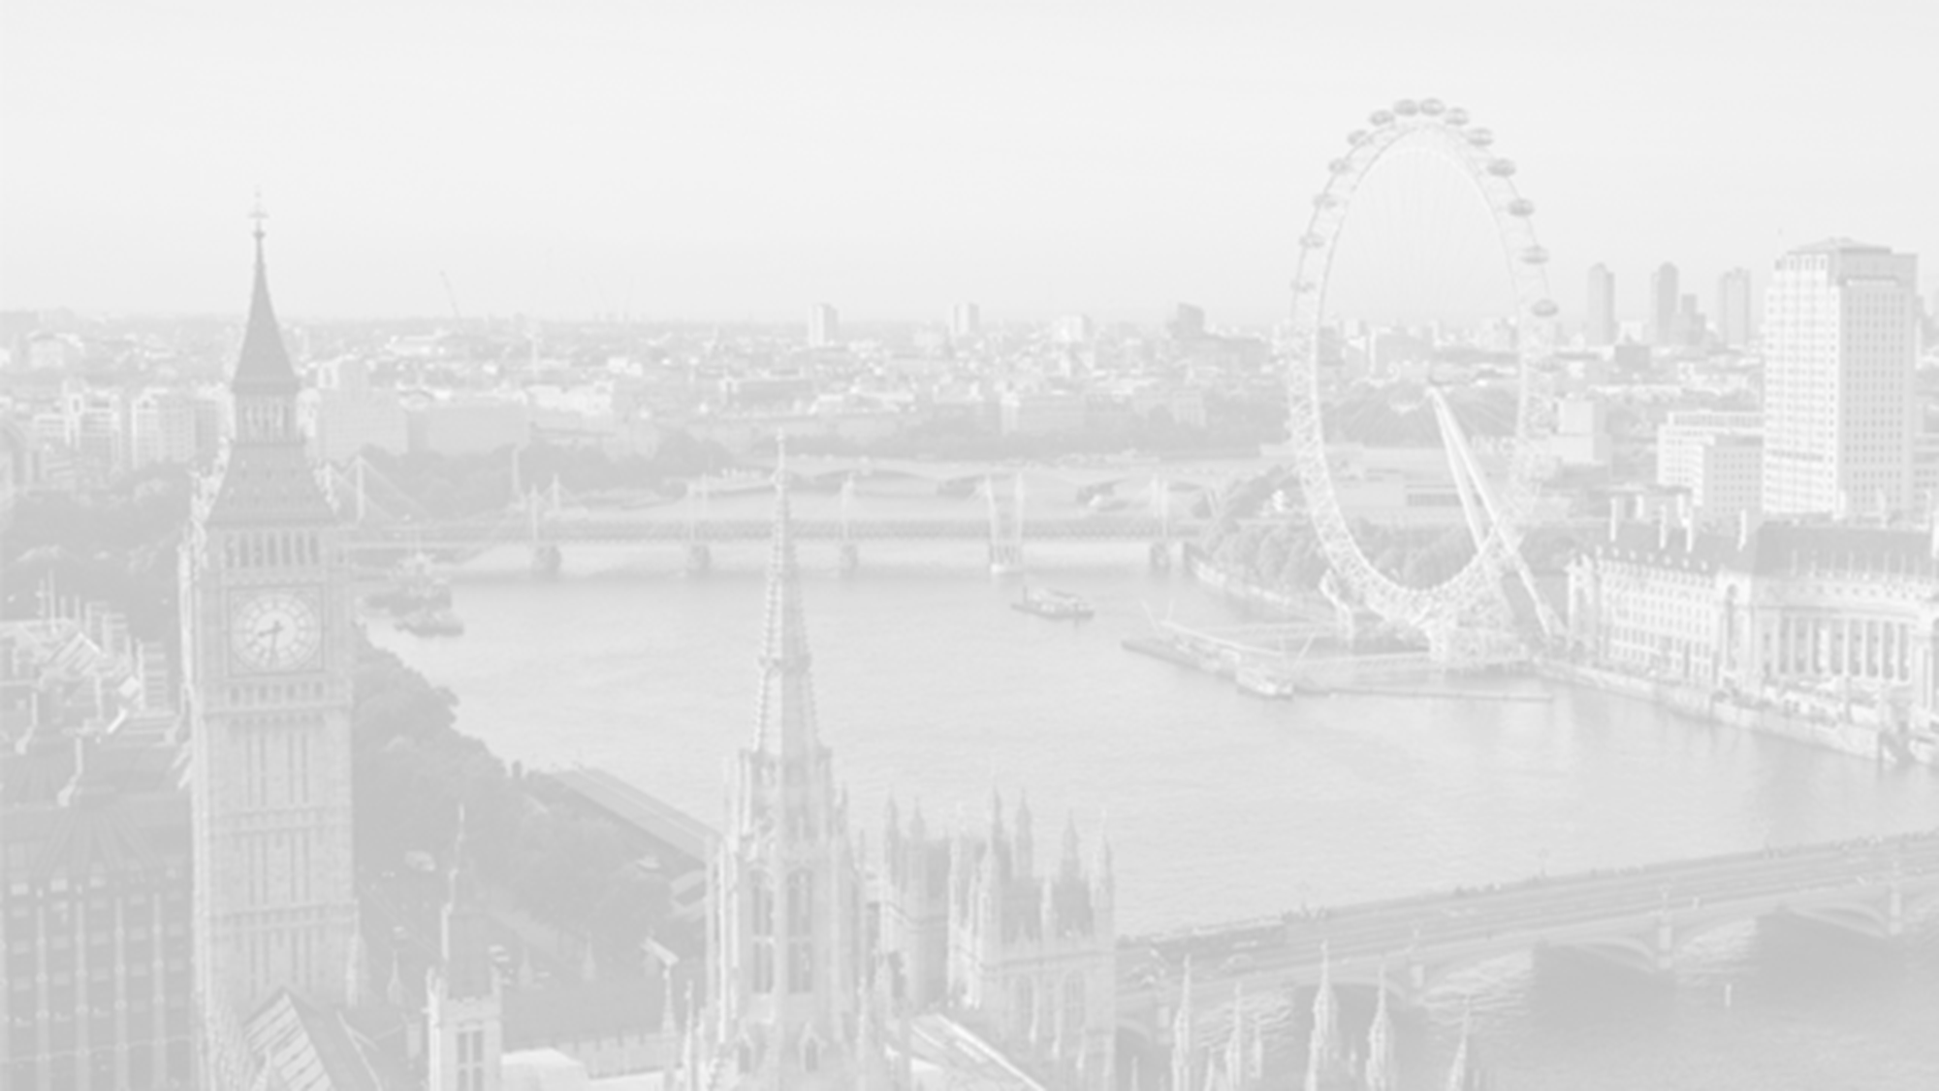
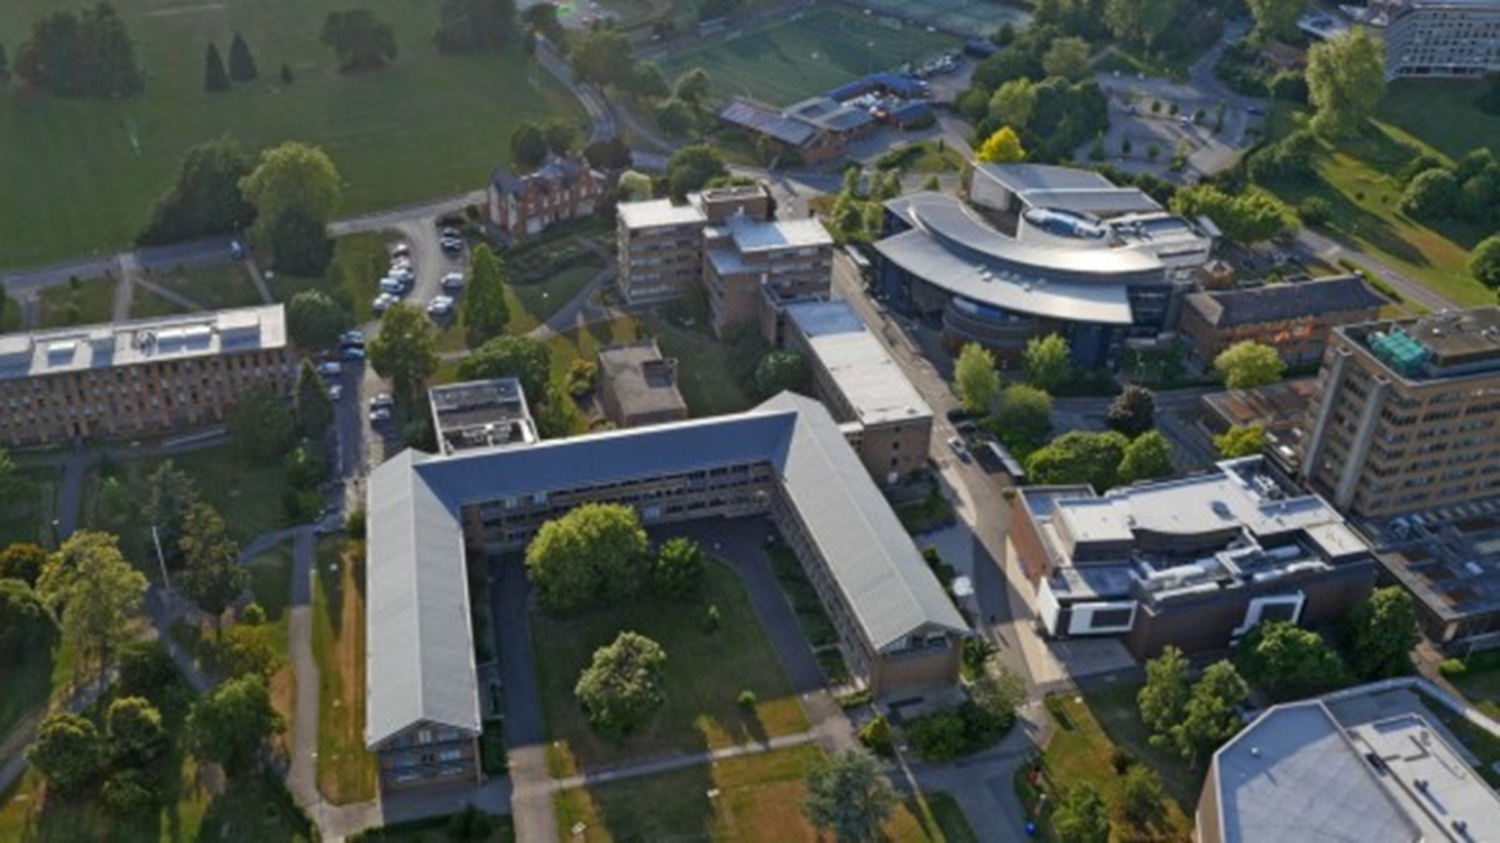
Summary
Leisure Side of travel resources not only for booking holidays.
Educating users on the Berkshire area.
Keeping the surprise element of going on a trip without a travel resources.

Slide 19
Solutions & Prototypes

Slide 20
Solution 1 : for First HMW
HMW Educate people on the local Berkshire area and showing the available activities?
Solution :
We can build a website that enables to not only plan and discover places to travel in the Berkshire area but allows users to read up on historic facts and figures if they choose to.

Slide 21
Solution 2 : for HMW 2
HMW make travelling more convenient?
Solution :
Build a website that is available 24/7 and enable cross platform access so it can be visited at home and on the go.

Slide 22
Solution 3 : for HMW 3
HMW implement the surprise element and adventurous
Solution :
Build a website that enables a hidden feature and allows user reviews and location to be the basis on users selecting a place to travel

Slide 23
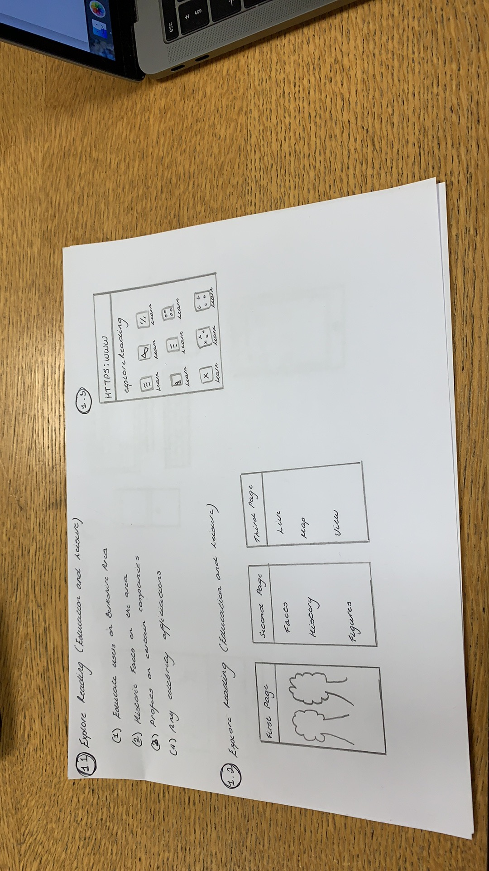
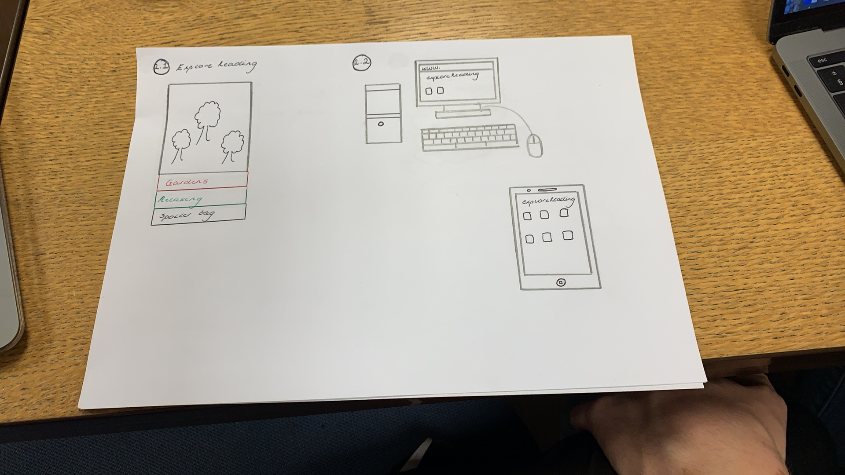
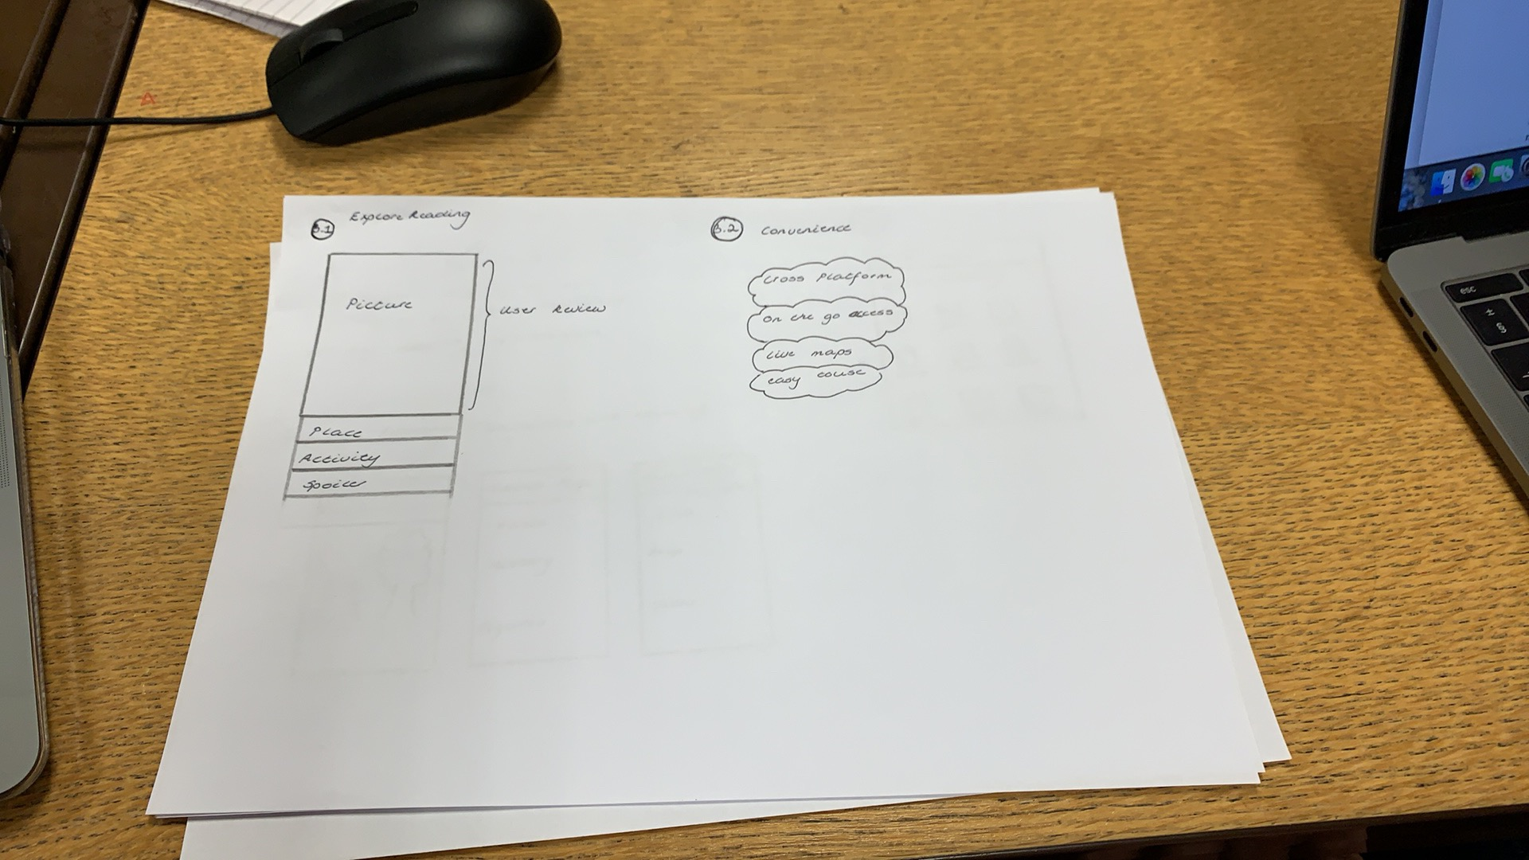
Prototype

Slide 24
Conclusion

Slide 25
“Explore Reading” Travel Website
Solution 1 and 2 to be the main focus while building the website
Solution 3 can not be implemented until later after deployment so is not viable to plan around

Slide 26
Thank You

Slide 27
Resources
1. https://www.interaction-design.org/literature/article/empathy-map-why-and-how-to-use-it [last visited 01/03/2019]
2. https://www.interaction-design.org/literature/article/stage-3-in-the-design-thinking-process-ideate
3.
4.
5.
6.
7.
8.
9.
10.

